Slide 1
“Against you only have I sinned”
2 Samuel 12

Slide 2
What is forgiveness?
God is not mocked
Forgive as you have been forgiven

Slide 5
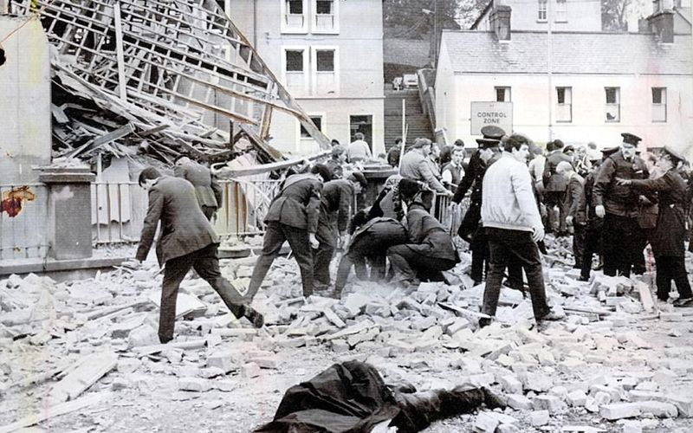

Slide 7
God is not mocked

Slide 12
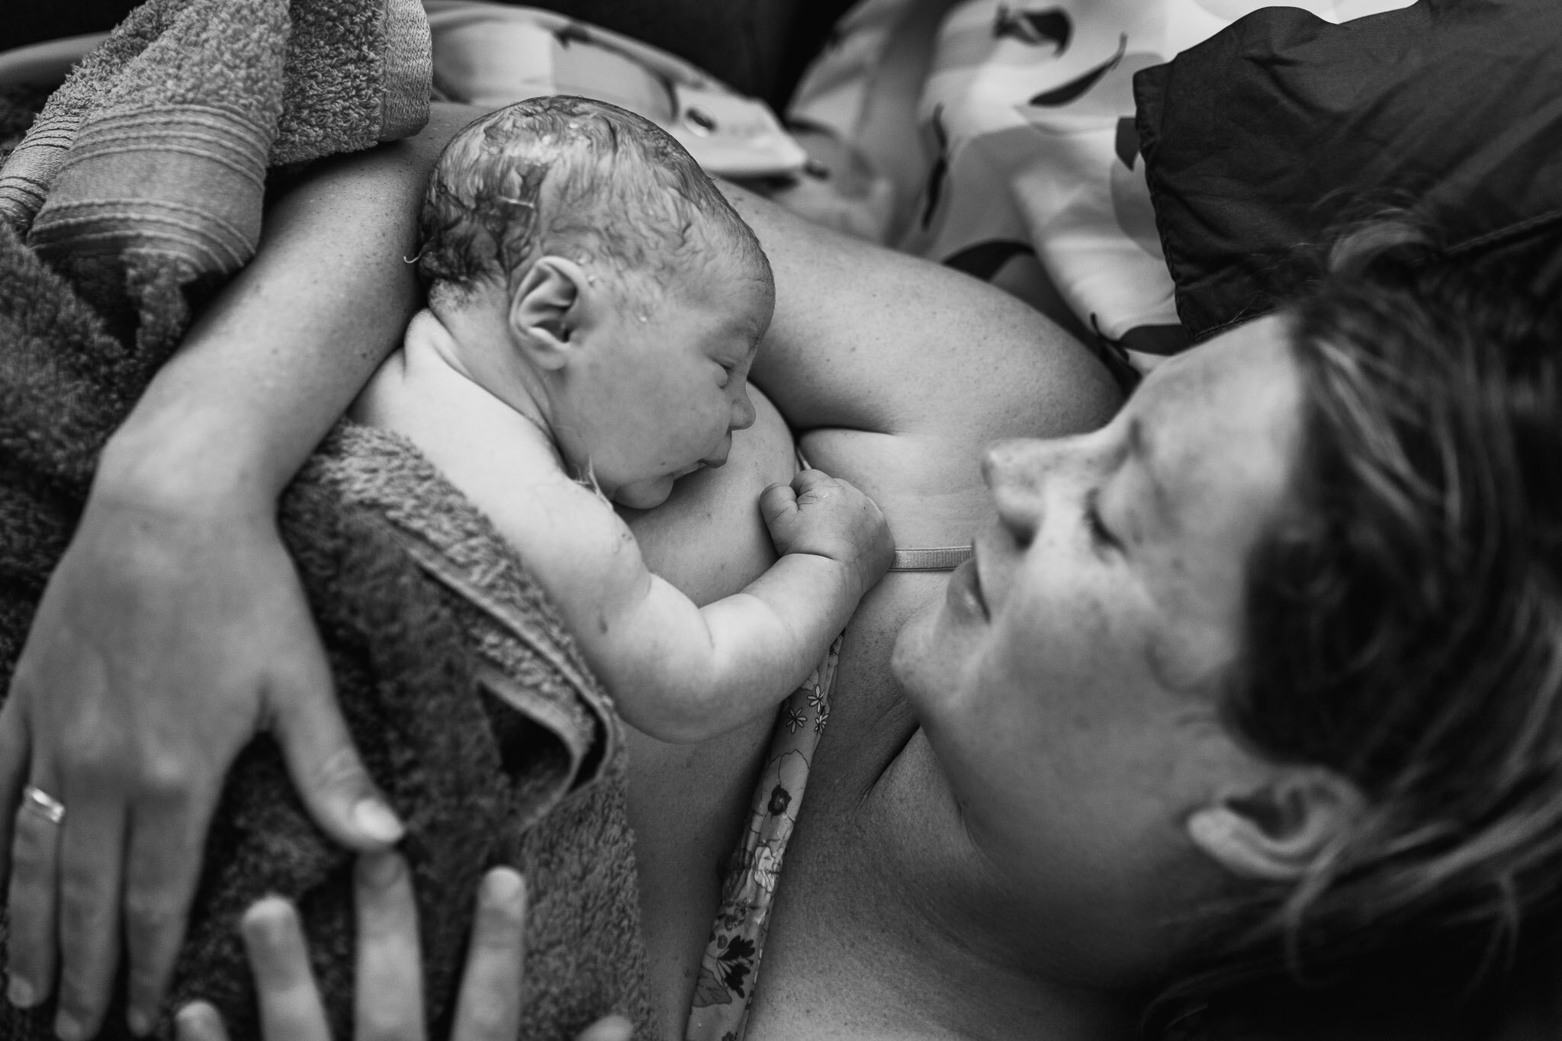

Slide 13
Forgive as you have been forgiven

