Slide 1
Life under the sun; life under the Son
Ecclesiastes 1:1-18

Slide 2
Life under the sun is meaningless
There is nothing new under the sun
Wisdom under the sun brings grief, wisdom under the Son brings joy

Slide 4
There must be a place under the sun Where hearts of olden glory grow young There must be a place under the sun Where hearts of olden glory grow young…
…Then I began to see the sun and the moon As I wandered round in orbit on this land that I called home No Messiah up in the sky that I could ever see That I could ever know to find my soul
All I had done below the sun would count for nothing In the turning of the world When there is nowhere left to go, you walk alone Watch the void eclipse it all

Slide 7
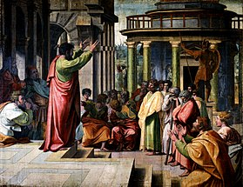

Slide 9
Wisdom under the sun brings grief

Slide 11
There is a place under the Son,
where hearts of olden glory grow young.

