Slide 3
Life in the Haze: Duty of Man
Listen to God’s Wisdom (v.9-11)
Fear Him and Keep His Commands (v.12-13)
Everything Matters (v.8, 14)

Slide 5
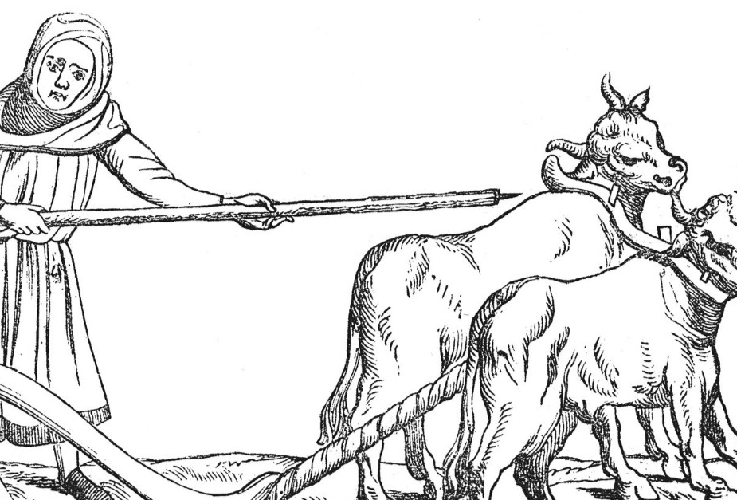
11 The words of the wise are like goads, their collected sayings like firmly embedded nails—given by one shepherd.

Slide 8
2. Fear Him and Keep His Commands (v.12-13)
“Be warned, my son, of anything in addition to them. Of making many books there is no end, and much study wearies the body” (v.12).
We cannot fully understand how God runs this fallen world!

Slide 9
2. Fear Him and Keep His Commands (v.12-13)
“Now all has been heard; here is the conclusion of the matter: Fear God and keep his commandments, for this is the duty of all mankind” (v.13).

Slide 10
2. Fear Him and Keep His Commands (v.12-13)
“Now all has been heard; here is the conclusion of the matter: Fear God and keep his commandments, for this is the duty of all mankind” (v.13).
Fearing him means trusting him
Fearing him means keeping his commands

Slide 13
3. Everything Matters (v.8, 14).
9 Not only was the Teacher wise, but he also imparted knowledge to the people. He pondered and searched out and set in order many proverbs. 10 The Teacher searched to find just the right words, and what he wrote was upright and true.

Slide 14
3. Everything Matters (v.8, 14).
Fear the Lord and keep his commandments,
For God will bring every deed into judgment, including every hidden thing, whether it is good or evil.

